Slide 1

Artificial Neural Networks & Genetic Algorithm
http://www.livewirenamakkal.com/
https://www.instagram.com/azartechnet/
https://www.instagram.com/livewirenamakkal/

Slide 2
Introduction of Artificial Neural Networks
The term "Artificial neural network" refers to a biologically inspired sub-field of artificial intelligence modeled after the brain.
An Artificial neural network is usually a computational network based on biological neural networks that construct the structure of the human brain.
Similar to a human brain has neurons interconnected to each other, artificial neural networks also have neurons that are linked to each other in various layers of the networks.
These neurons are known as nodes.

Slide 3
Introduction of Artificial Neural Networks
Artificial neural network tutorial covers all the aspects related to the artificial neural network.
we will discuss ANNs, Adaptive resonance theory, Kohonen self-organizing map, Building blocks, unsupervised learning, Genetic algorithm

Slide 4
What is Artificial Neural Network?
The term "Artificial Neural Network" is derived from Biological neural networks that develop the structure of a human brain.
Similar to the human brain that has neurons interconnected to one another, artificial neural networks also have neurons that are interconnected to one another in various layers of the networks. These neurons are known as nodes.

Slide 5
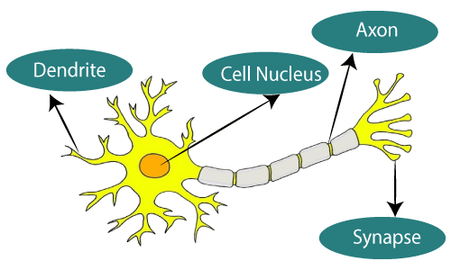
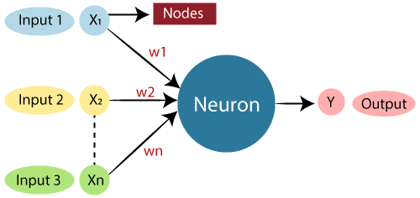
The given figure illustrates the typical diagram of Biological Neural Network.
The typical Artificial Neural Network looks something like te given figure.

Slide 6
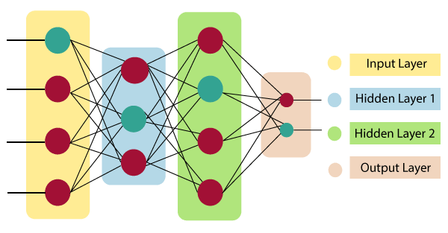
Artificial Neural Network primarily consists of three layers

Slide 7
Advantages of Artificial Neural Network (ANN)
Parallel processing capability
Storing data on the entire network
Capability to work with incomplete knowledge
Having a memory distribution

Slide 8
Disadvantages of Artificial Neural Network
Assurance of proper network structure
Unrecognized behavior of the network
Hardware dependence
Difficulty of showing the issue to the network

Slide 9
Genetic Algorithm in Machine Learning
A genetic algorithm is an adaptive heuristic search algorithm inspired by "Darwin's theory of evolution in Nature." It is used to solve optimization problems in machine learning. It is one of the important algorithms as it helps solve complex problems that would take a long time to solve.

Slide 10
What is a Genetic Algorithm?
Before understanding the Genetic algorithm, let's first understand basic terminologies to better understand this algorithm:

Slide 11
Population: Population is the subset of all possible or probable solutions, which can solve the given problem.
Chromosomes: A chromosome is one of the solutions in the population for the given problem, and the collection of gene generate a chromosome.
Gene: A chromosome is divided into a different gene, or it is an element of the chromosome.
Allele: Allele is the value provided to the gene within a particular chromosome.
Fitness Function: The fitness function is used to determine the individual's fitness level in the population. It means the ability of an individual to compete with other individuals. In every iteration, individuals are evaluated based on their fitness function.
Genetic Operators: In a genetic algorithm, the best individual mate to regenerate offspring better than parents. Here genetic operators play a role in changing the genetic composition of the next generation.
Selection

Slide 12
Types of selection styles available
Roulette wheel selection
Event selection
Rank- grounded selection

Slide 13
How Genetic Algorithm Work?
The genetic algorithm works on the evolutionary generational cycle to generate high-quality solutions. These algorithms use different operations that either enhance or replace the population to give an improved fit solution.
It basically involves five phases to solve the complex optimization problems, which are given as below:
Initialization
Fitness Assignment
Selection
Reproduction
Termination

